Slide 1
Phase 3 (champion chicken)
Erick Enriquez

Slide 2
Project Idea
The idea of the project was to create an application that could be used by fellow chicken lovers in order to fulfill their desire to have platform to express and enjoy their passion, while exposing them to entirely new chicken experiences

Slide 3
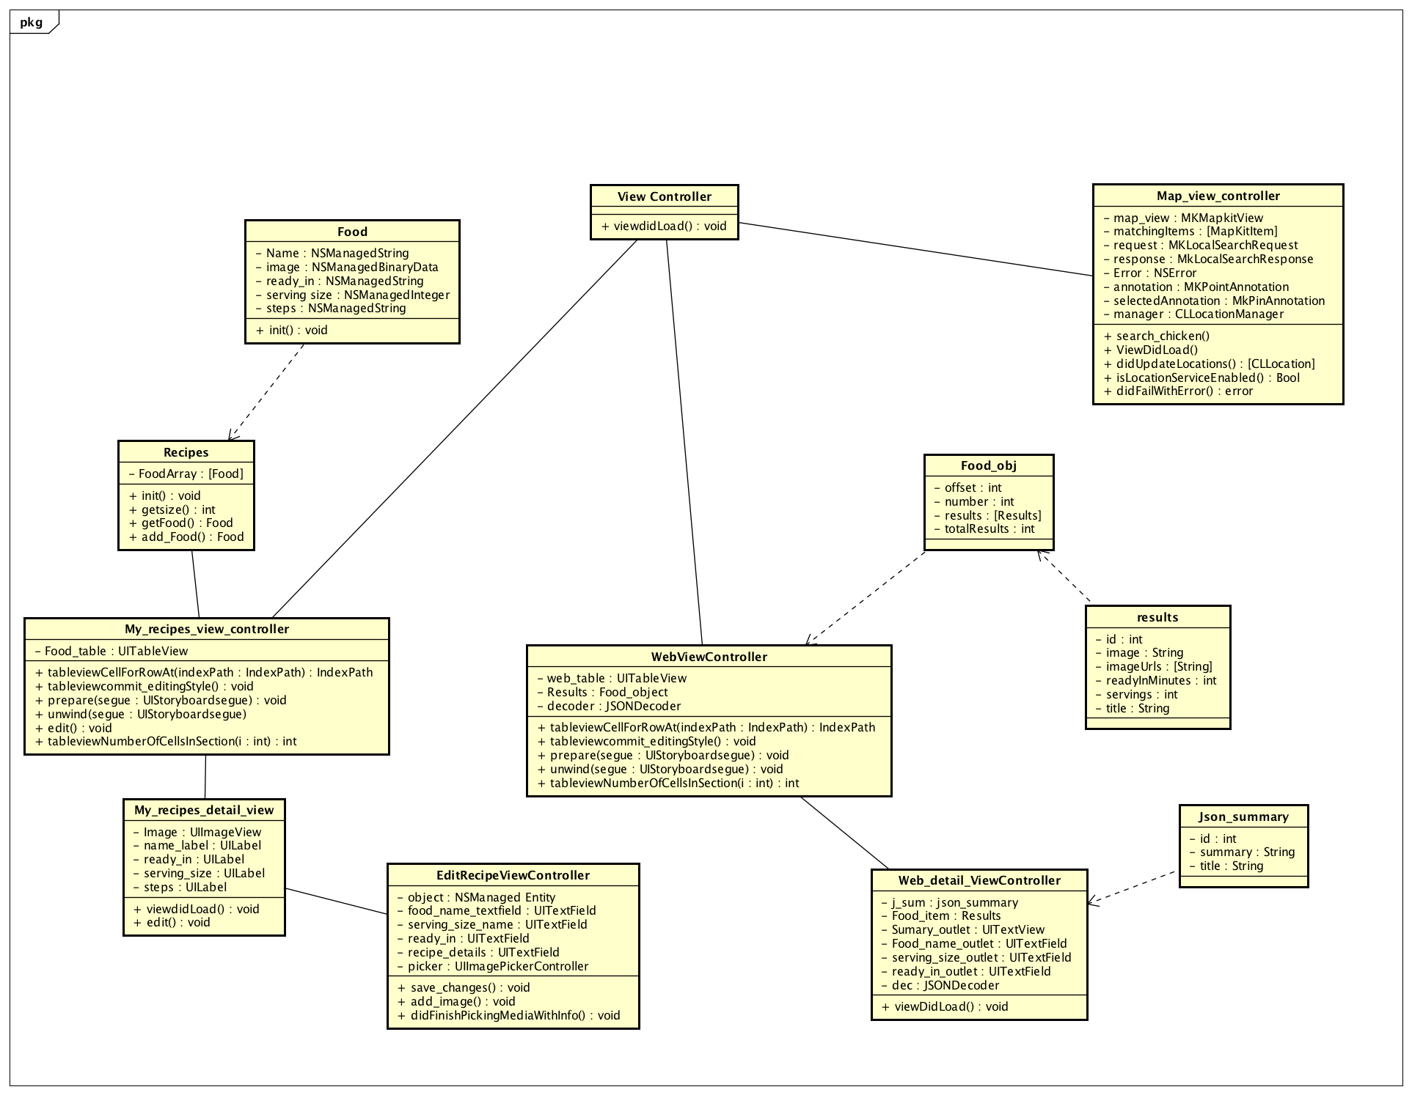
Class Diagram

Slide 4
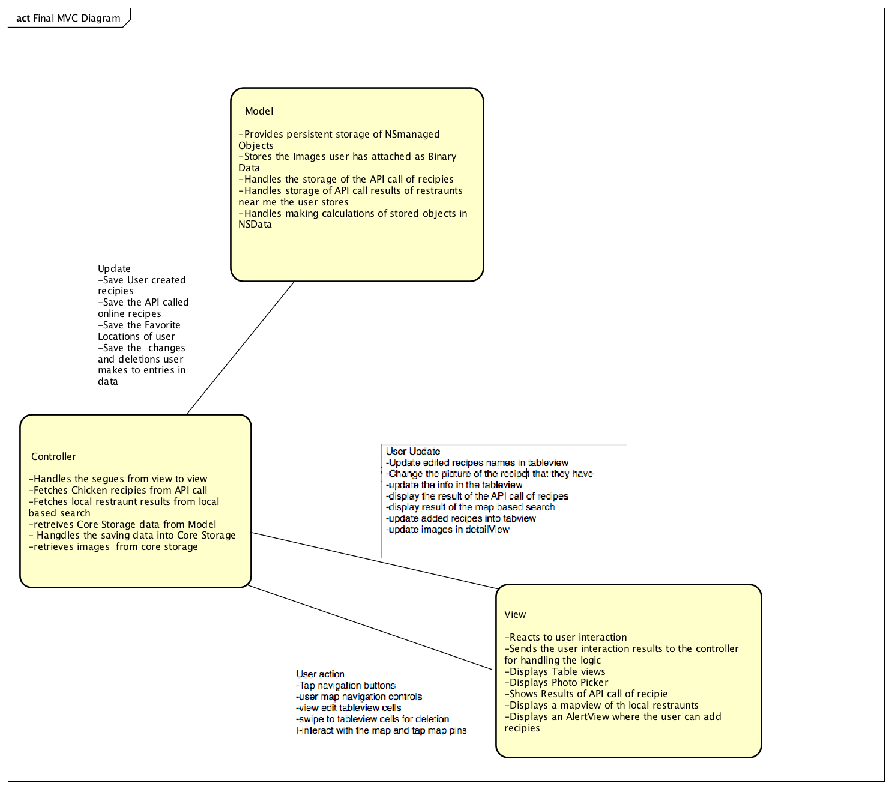
MVC Diagram

Slide 5
Capabilities/ Limitations
Some of the capabilities of the app that I have created include
Allowing users to store and take pictures of their recipes of chicken
Showing users chicken restaurants near their location
Demonstrating to user's, recipes created online that they can enjoy
Some of the limitations of the project are
There is currently no option for the user to get driving directions to restaurants
There is currently no option that allows users to post their info to social media
The aesthetic of the project is not up to par with most everyday apps that are utilized

Slide 6
Lessons Learned
Throughout this project the hardships that arises I was able to overcome, but when it came to the designing and making the look for others I was quite stumped.
I learned that I am not a person who has a keen eye for making things look aesthetically pleasing
I learned that to create an app that is actually useful for a purpose requires that a lot of effort be put in to the little things to ensure users don’t accidently break the code
I also learned that using MVC architecture is very important and helpful to keep your code clean and manageable

Slide 7
Suggestions for improvements
Some improvements that could be done for my project in order to make it more useful and better include:
Include functionality to allow navigation from user location to the restaurant they selected
Include functionality to let users post their recipes to social media
Connect the restaurants to their yelp reviews so users can see their reviews as well as be able to do it from there
Overall just have the app look more aesthetically pleasing, ie) adding colors to view’s, making buttons look nicer

